Slide 1

Winged Deer Park Economic Impact Study
Kent Roller, Toby Adebiyi, Adade Yeboah
Kevin Willis, Richard Ojo, Katelyn Williams

Slide 2

Outline
Project Goals
Initial Data Sets and Analysis
Multiplier Effect and Impact Estimation
Input Output Model

Slide 3
Project Goals
Collect all possible data from local government sources
Distribute created survey to obtain additional data
Use
Secondary Studies
for data not found
in previous steps.
Create estimates for each sport based on preceding data
Apply multipliers using RIMS II I/O model table for the region
Notes:
Change chart to show flow better/order

Slide 4
Initial Data Analysis
Some initial calculations made with data received and assumption of
$206/day spending.
Notes:
Ask about day amount add per individual

Slide 5
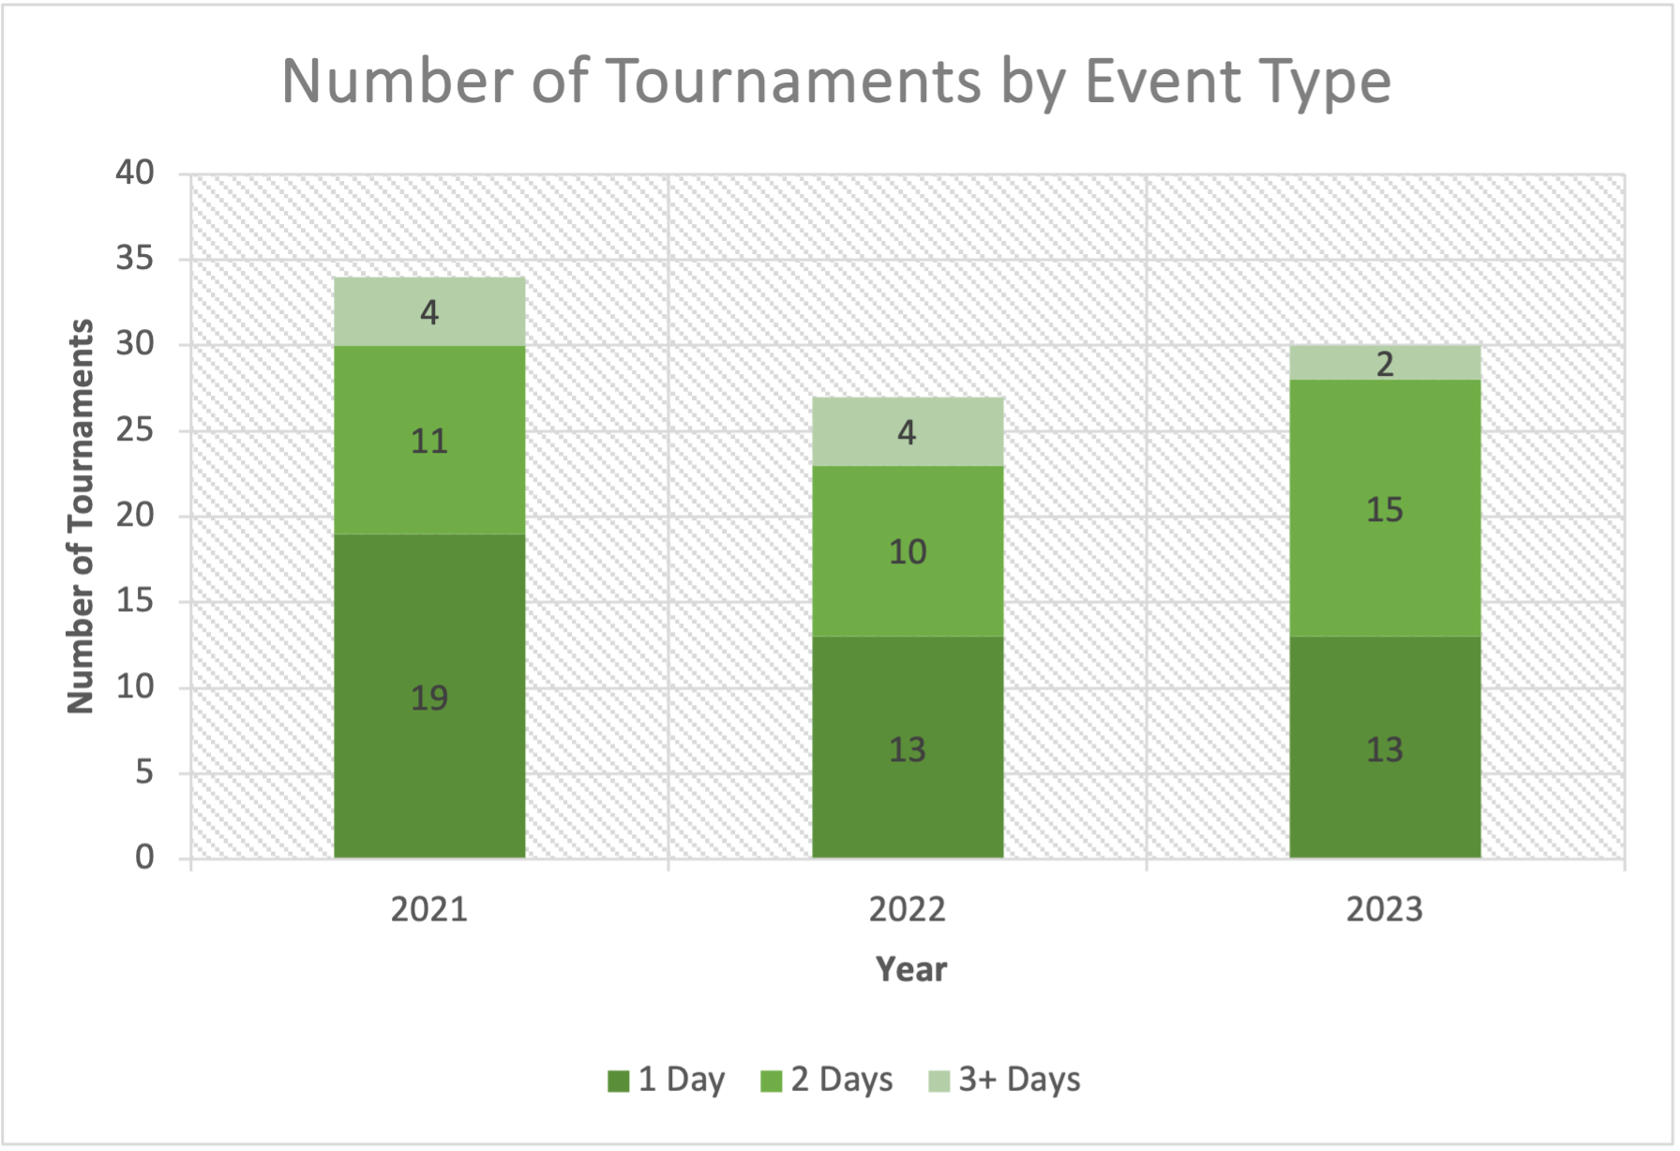
Number of Tournaments by Event Type per Year

Slide 6
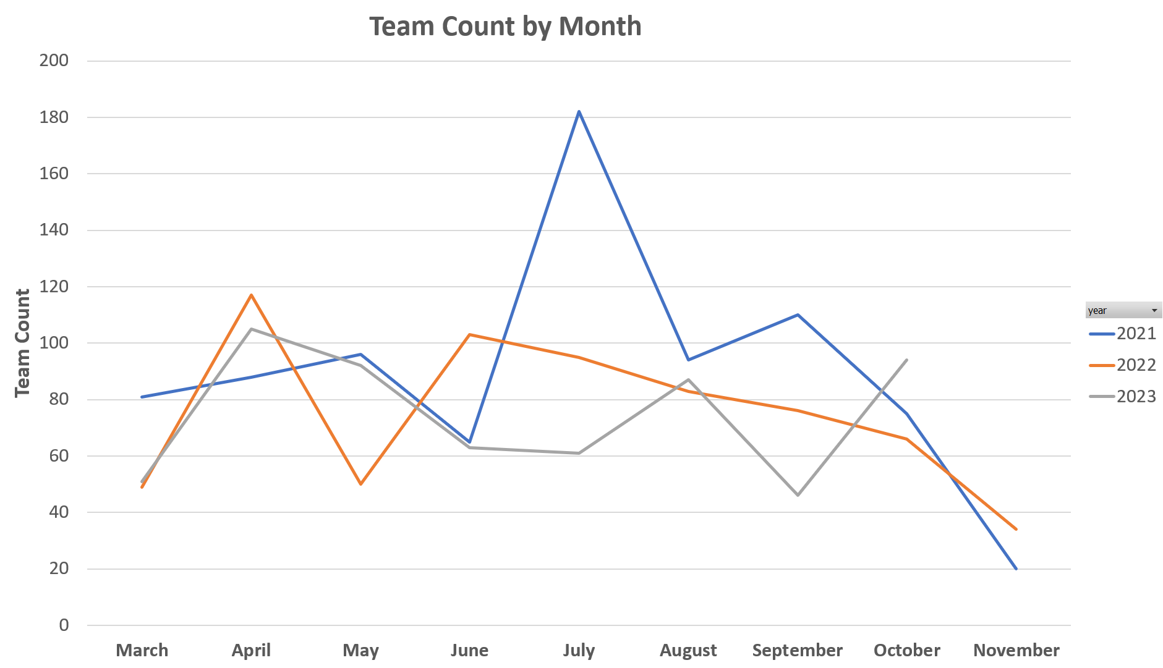
Number of Teams by Month
Total Number of Teams per Month Compared

Slide 7
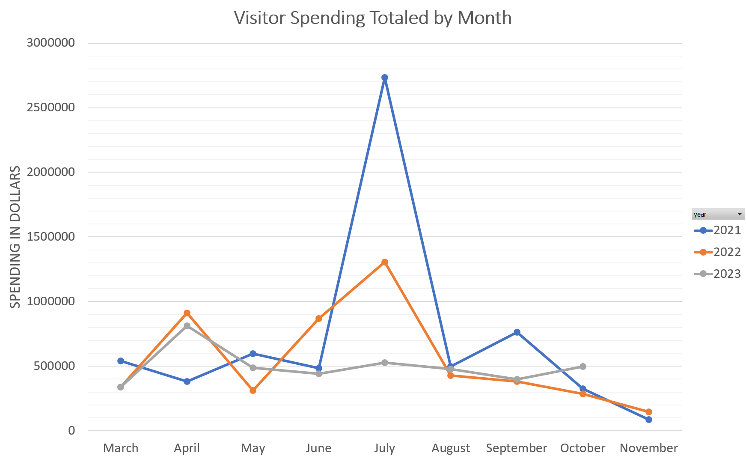
Visitor Spending Totals by Month
Visitor spending totals by month for each year

Slide 8
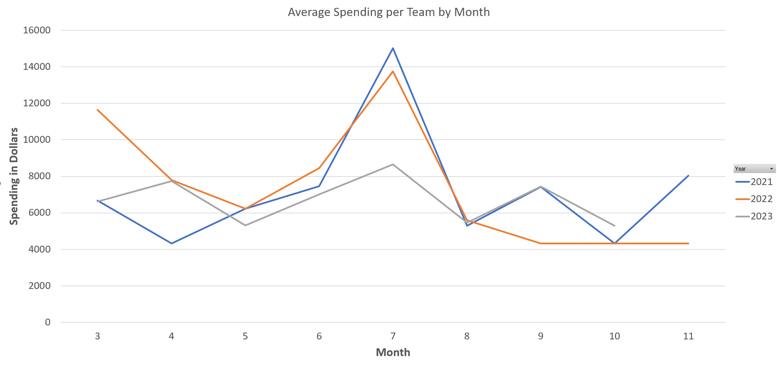
Average Spending by Team
Here we have a breakdown of the average spending per team over time so we
can compare spending by team between years
Notes:
Trend line

Slide 9
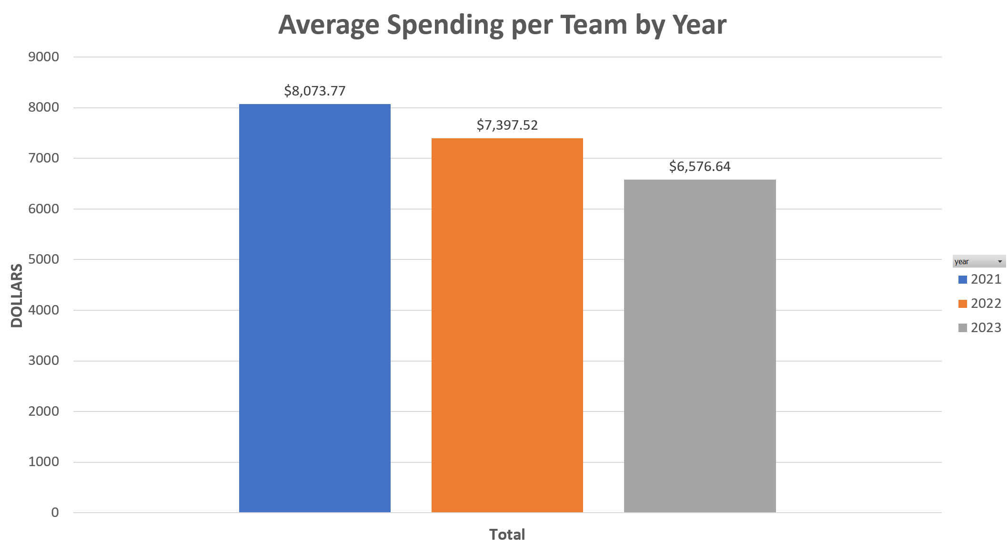
Average Spending per Team by Year
Here we see what each team spent on average compared by year. Unfortunately,
this number appears to be decreasing.
Notes:
Round number to dollar amount, add $ sign

Slide 10
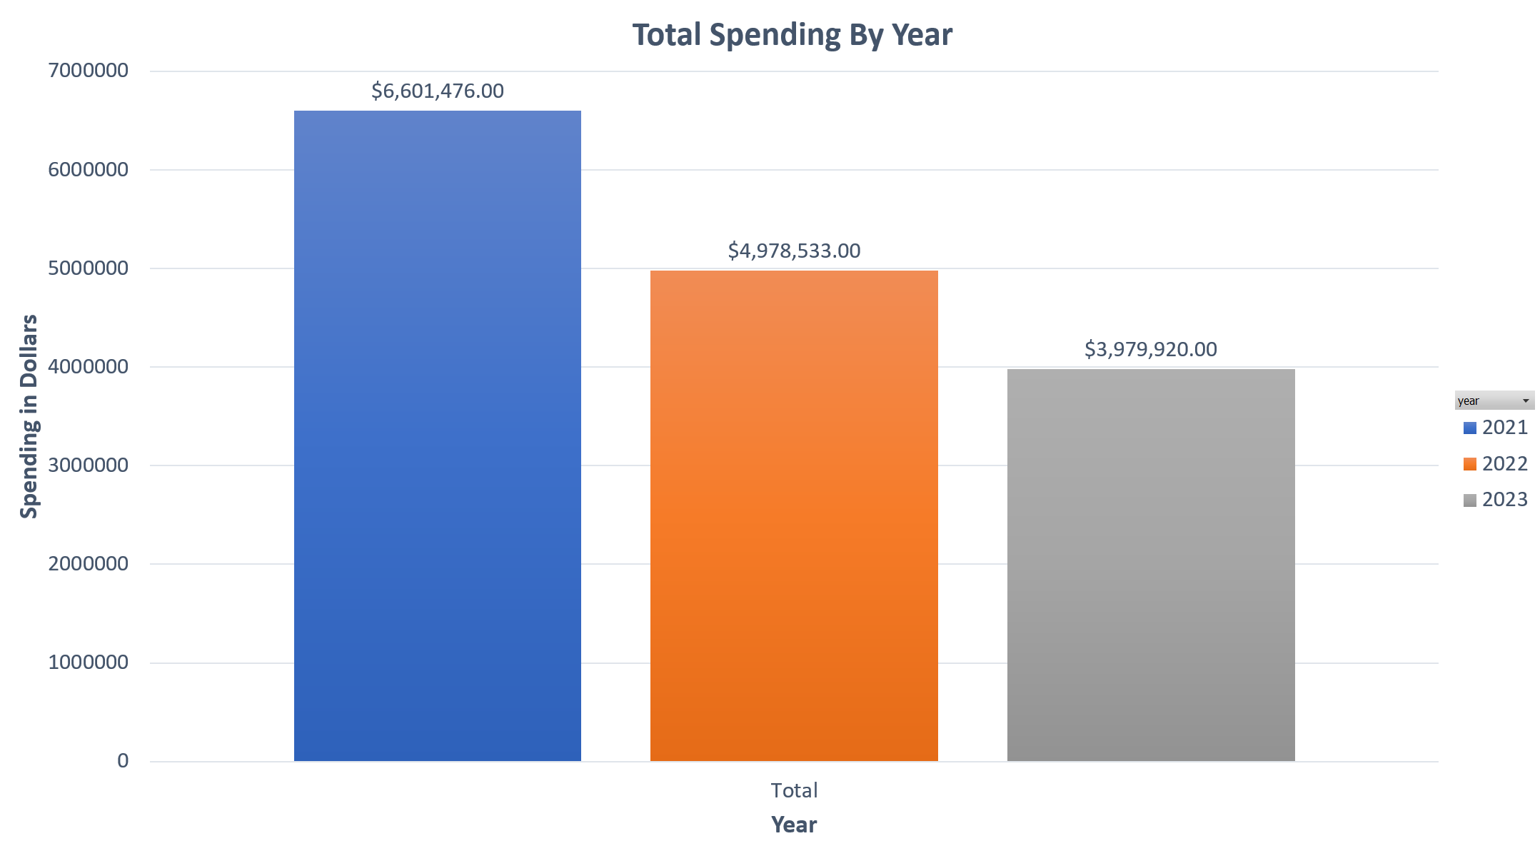
Total Spending by Year
Total visitor spending compared by year

Slide 11
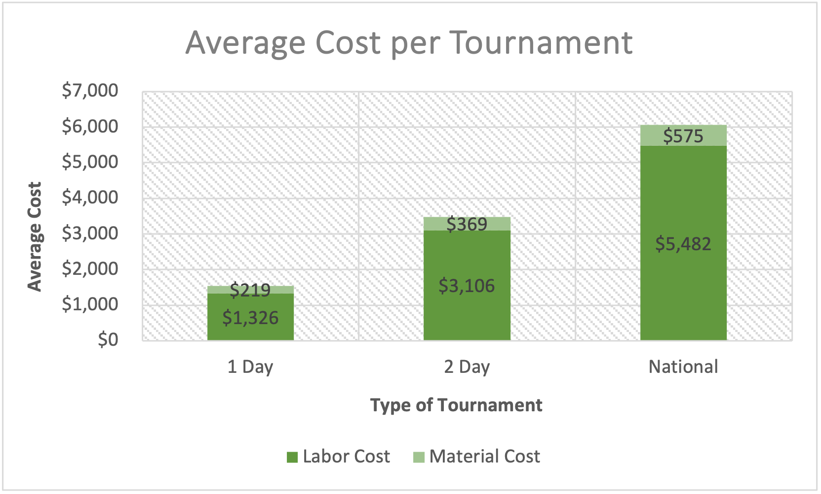
Average Maintenance Cost per Type of Tournament
Total Cost for 1-Day Tournament: $1,545
Total Cost for 2-Day Tournament: $3,475
Total Cost for National Tournament: $6,057
Notes:
bigger

Slide 12
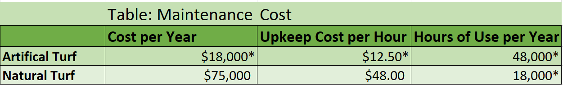
Field Type Comparison
Using supplied data summed expenses for year to find total cost of field maintenance.
This is compared to the total hours of use each field can support per year.
*Note: the values with asterisk beside them were found from materials from the artificial turf manufacturers own information/sales literature.
Notes:
Plot with bars side by side, colors to correspond, title

Slide 13

USA Softball 18U National Championship July 2023 Data
The USA Softball National Tournament is one of the largest tournaments hosted by Visit JC each year.
In 2023, this 5-day event was held at Winged Deer Park for the 18U Girls Class 'A' Fastpitch softball.
Total Attendees | 1,320
Average Spent per Day | $132
Average Hotel Rate per Night | $118
Total Visitor Spending | $871,200
Sales Tax Revenue | $10,995
Lodging Tax Revenue | $9,499

Slide 14
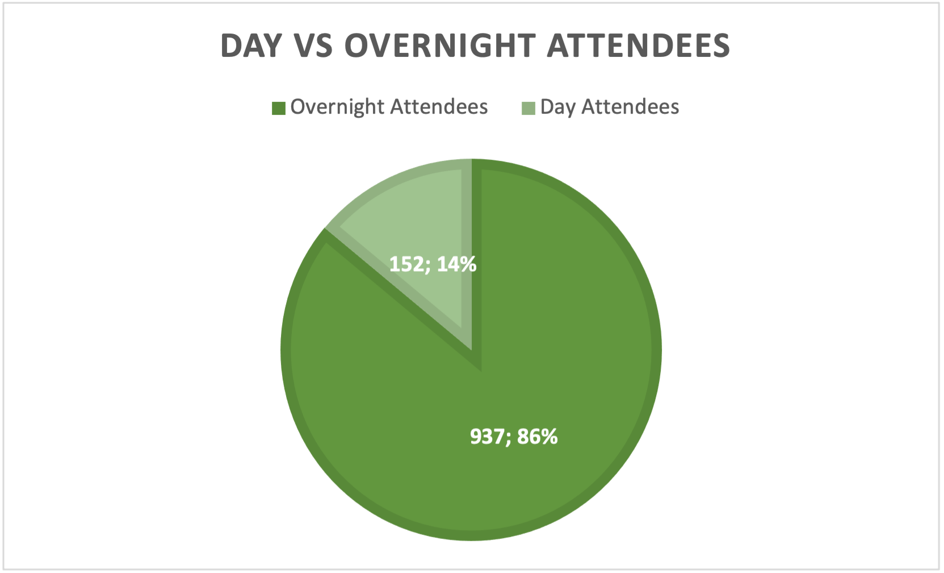
USA Softball 18U National Championship Attendee Type
Notes:
Add semicolon

Slide 15
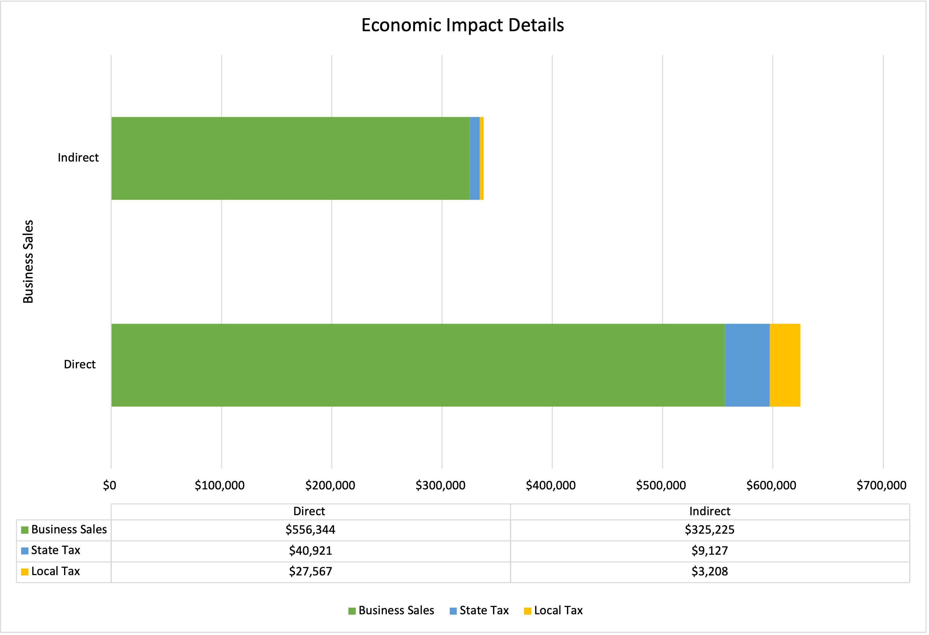
USA Softball 18U National Championship Economic Impact Details
Notes:
Stacked for direct and indirect, separate

Slide 16
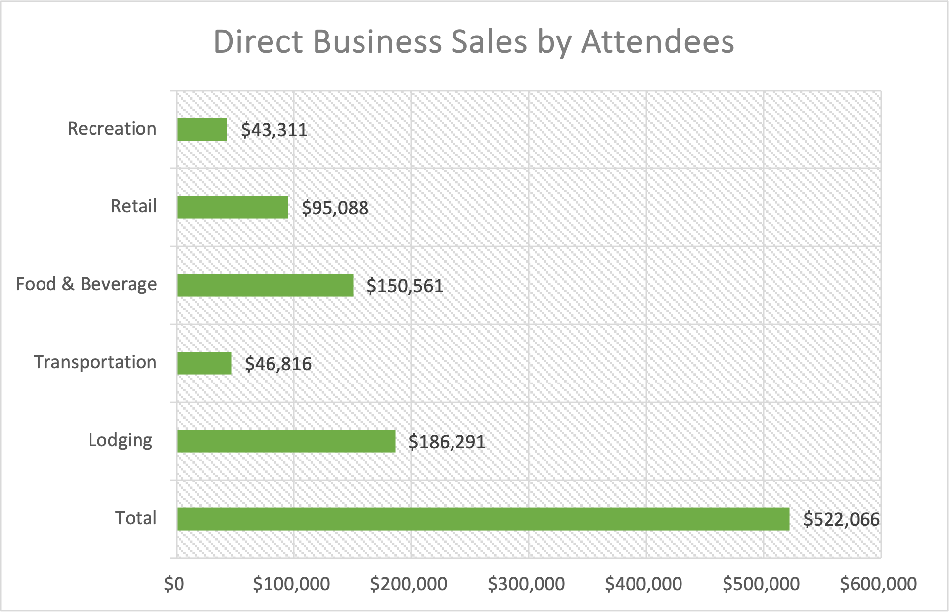
USA Softball 18U National Championship Direct Business Sales

Slide 17
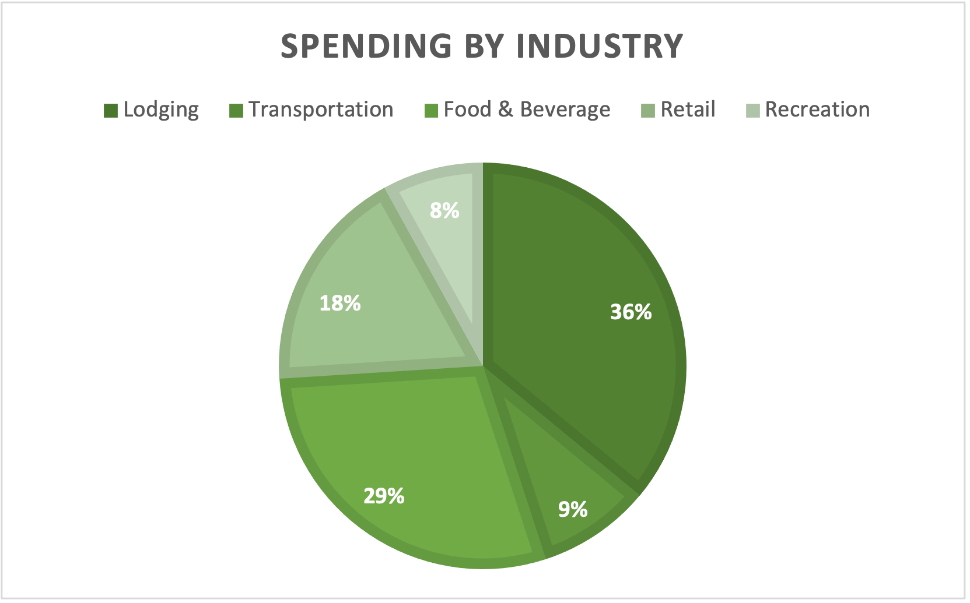
USA Softball 18U National Championship Direct Business Sales by Industry

Slide 18
The Multiplier Effect and Estimates

Slide 19
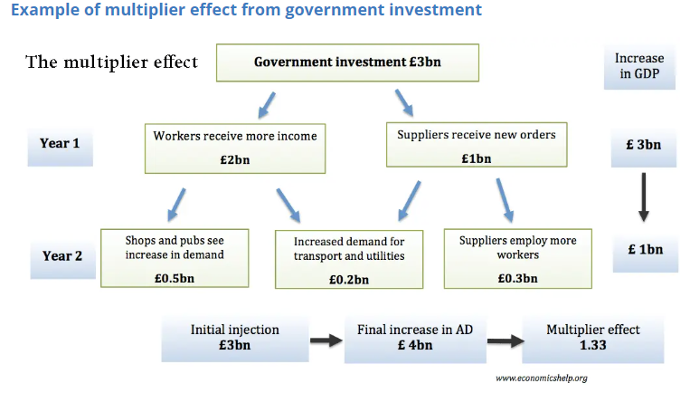
Multiplier Effect
How the multiplier effect works with a 3-billion-pound initial investment

Slide 20
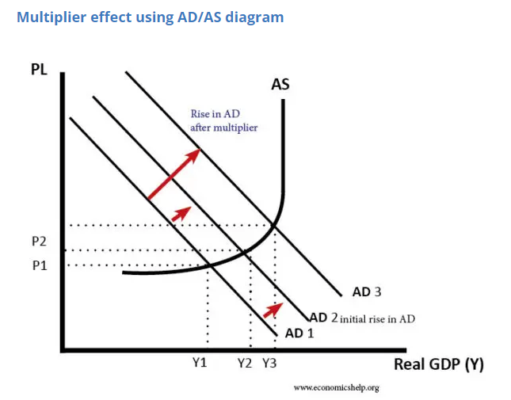
Multiplier Effect Pt2
Multiplier Effect on Aggregate Demand, Reflecting outside spending in an economy

Slide 21
How The Estimates Are Created
JC population 71,278
Population Density in Thousands=0.407
Chang’s Multiplier: 1.566+0.6*ln(Pop)-0.009(PopDen)
Using our values this yielded: 1.4583
We also add a capture rate of 60-70% to account for leakages in the local economy
This allows for an initial impact assessment
Utilizing a secondary study, we find a Multiplier for use with our data that doesn’t use the input/output model typically used.
Notes:
Add something to show that we intialy looked at the Changs methods, one way we could have looked at it but we ended
This only gives us one value but the other is more refined so we used the RIMS II
Summary of two different methods (one is useful in explaination but other is better)

Slide 22
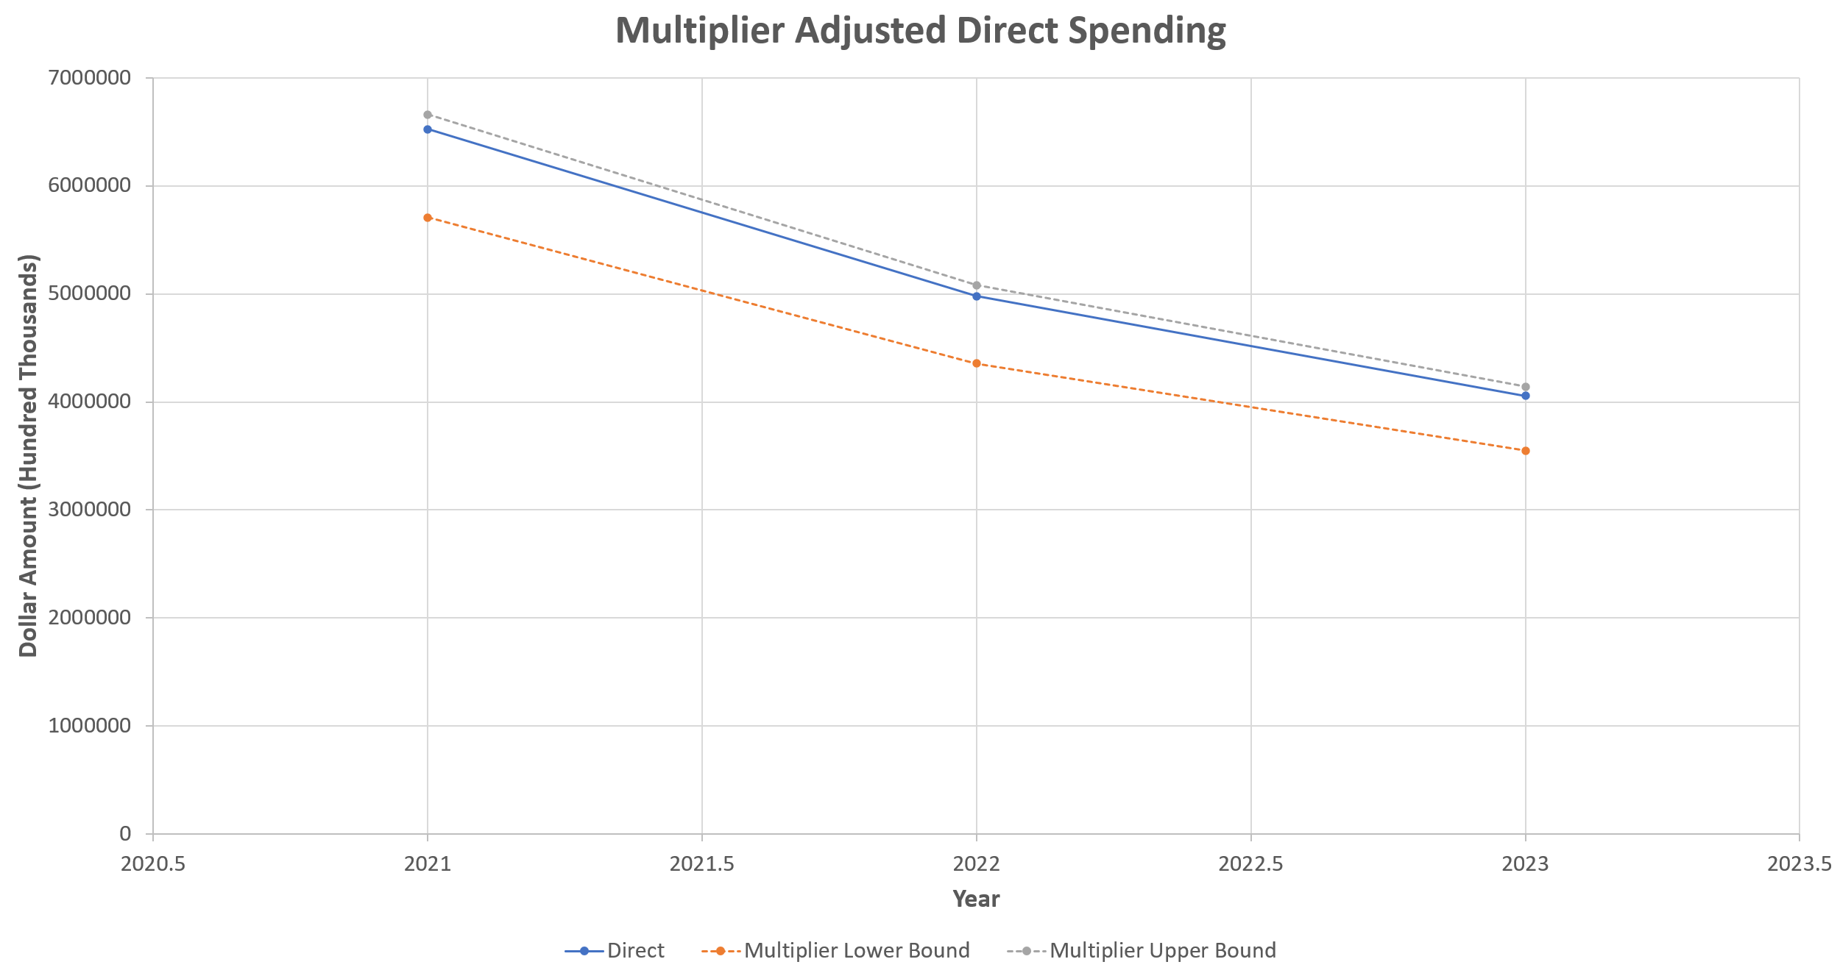
Adjusted Spending Totals
Whisker Plot displays new range calculated for Revenue using Multiplier

Slide 23
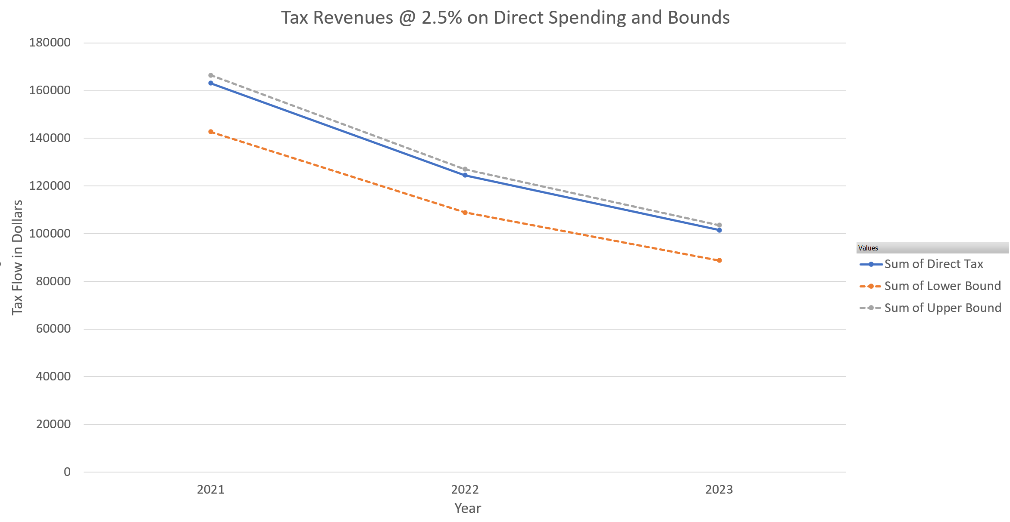
Adjusted Tax Revenues
Whisker Plot of adjusted tax revenue, found using spending total per year
Multiplied by tax rate of 2.5% for local revenues
Notes:
*Adjusted, add direct trend line, add Washington county

Slide 24
A Brief Look At Input Output Models

Slide 25
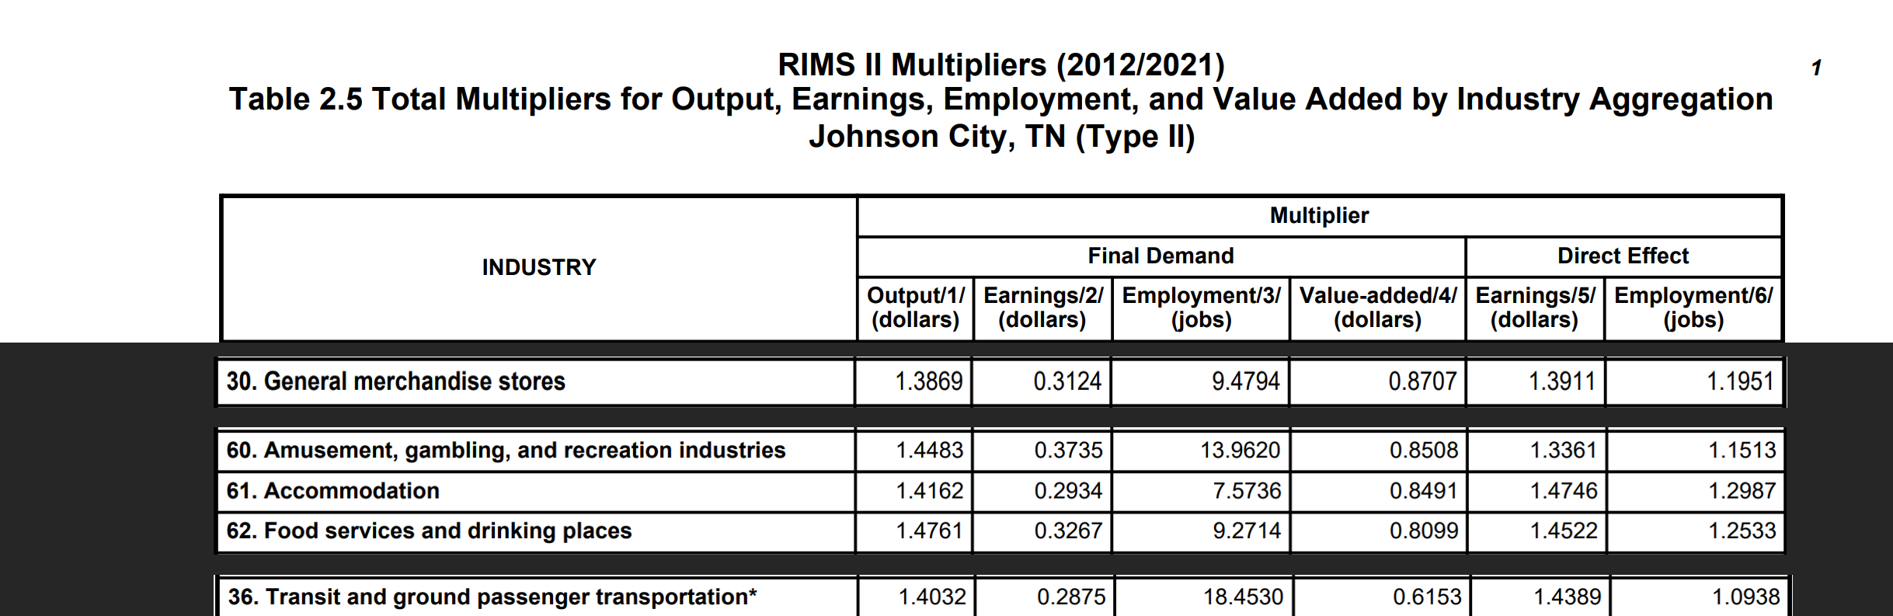
RIMS II Table Example w/Final Demand Multipliers
RIMS II Multiplier for the Johnson City area. This example shows how the multiplier
table takes in to account the specific production of a region.

Slide 26
Assumptions made when Using I/O model
RIMS II is a backward-linkage model
RIMS II uses Fixed Purchase Patterns
Industry Homogeneity
No Supply Constraints
No Regional Feedback
No Time Dimension

Slide 27
Additional RIMS II information
RIMS II multipliers are only meaningful for analyzing the impact of final demand change in a region. Final demand consist of a number of different types of transactions:
Purchases by consumers outside the region
Investment in new buildings, equipment, and software
Purchases by government
Purchases by households

Slide 28
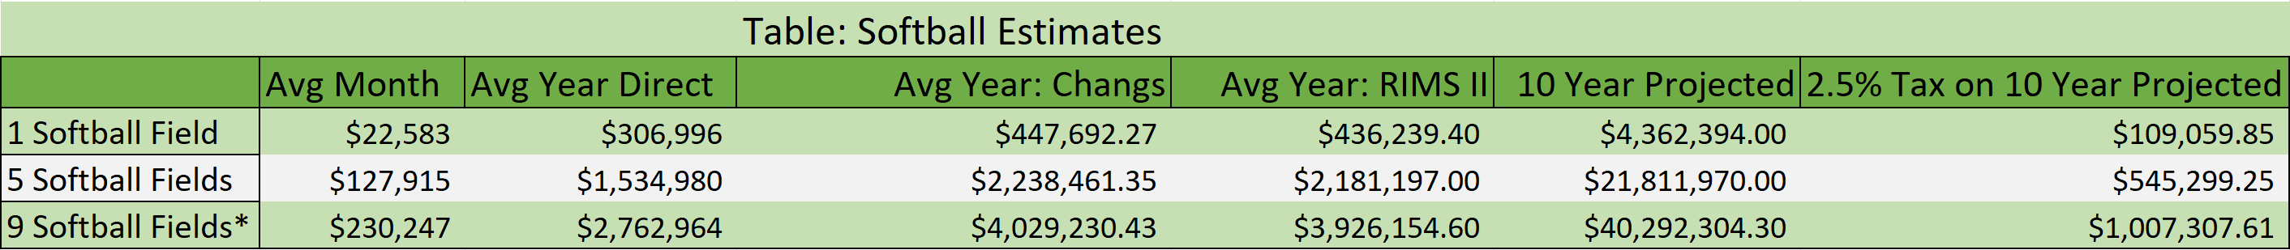
Spending by Sport: Softball
Estimates for visitor spending isolating softball and looking at 1 field, 5 field, and 9 field results. Month and Year are both direct estimates. Chang's applies the previously found 1.4583 to the estimates, and RIMS II applies the multipliers via appropriate methods, 10 year is based on multiplying the avg yearly amount, and tax is based on 2.5% tax rate applied to the 10 year projected value.
Notes:
Values, 1 per page
Possibly use a table instead of a graph

Slide 29
Spending by Sport: Baseball
Table: Baseball Estimations
 | Average Month | Average Direct | Avg Year: Changs | Avg Year: RIMS II | 10 Year Projected | 2.5% Tax on 10 Year Projected
5 Baseball Fields | $153,547.41 | $1,842,568.87 | $2,687,018.18 | $2,634,311.51 | $26,343,115.10 | $658,577.88
9 Baseball Fields | $314,470.30 | $3,773,643.60 | $5,503,104.46 | $5,395,159.38 | $53,951,593.80 | $1,348,789.85
Estimates are found using the following base equation for day trip events:
number of teams x 15 players per team x 2.14 attendees per player x $132 per person x 0.86 non-local attendees
To estimate the number of teams for the 9 fields, the average number of baseball teams from tournaments held in 2021-2023 is divided by 5 to calculate the average number of teams per field.

Slide 30
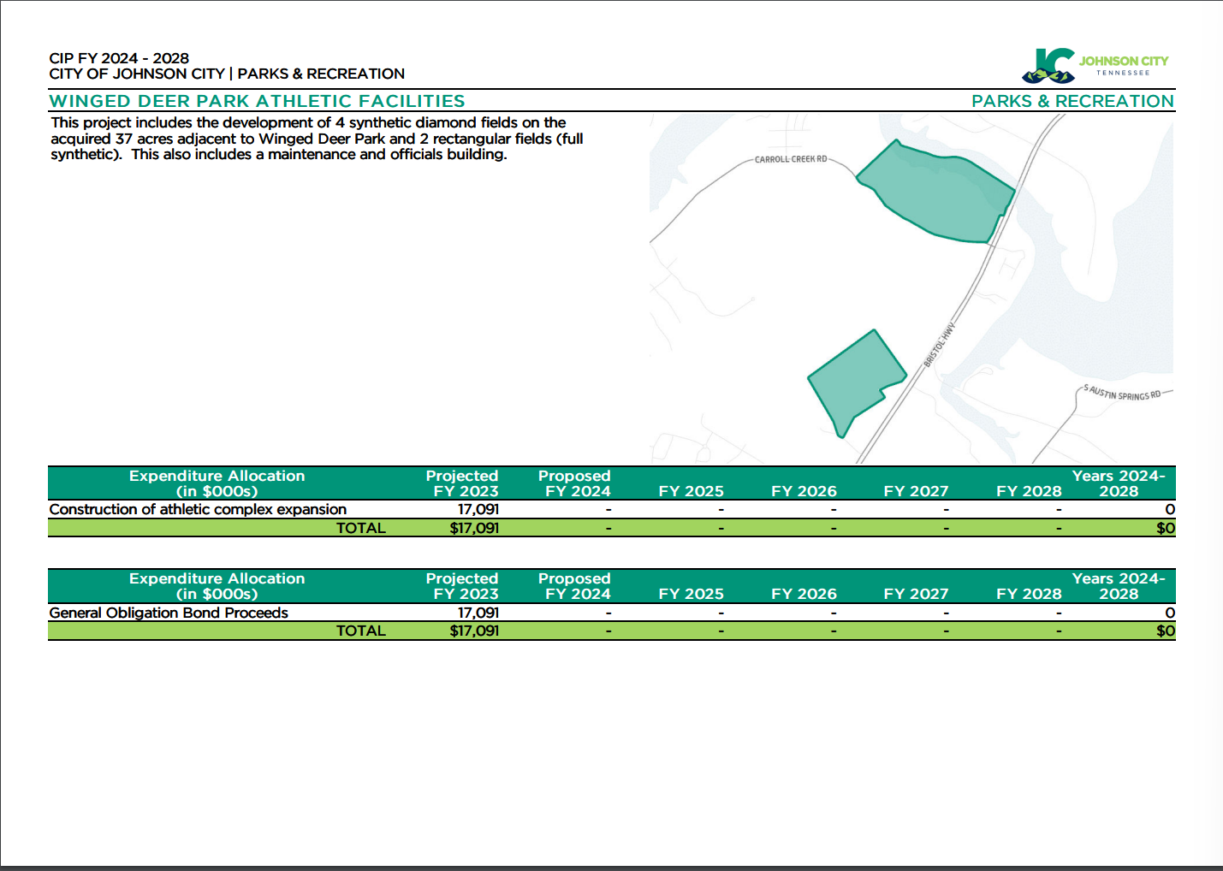
A Brief Look at the Fiscal Outcome
The park expansion is expected to run ~$17.1 million. But how will this investment affect the parks bottom line?

Slide 31
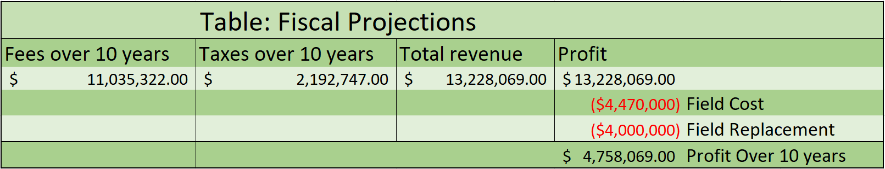
Projection for Park Revenue over the next 10 Years
In the table we can see the projected revenue income using the multiplied estimates for each sport and summed together to create an average. The field cost are based on provided and projected cost associated with current and replacement fields.

Slide 32
Conclusions from Estimates
With current revenues and expenses for the park, the park should be able to accomplish break even with cost within 15 years. (~12 years from end date)
With current fee structure park revenues are greater than park expenses when using generalized expense data.
Between fees and taxes park will be able to replace artificial turf fields with revenues from the fields without having to use additional fund for their upkeep.

Slide 33
Future Calculations
Work performed here can be expanded on as additional data is brought in.
Continue to track number of teams and participating in each tournament, but start classifying type of sport for each tournament
Continue to work with VisitiJC in order to obtain information about Visitor spending habits like industry breakdowns
Expand maintenance data kept such as additional work required per tournament such as pitchers mounds, rain outs, light usage, etc. To better account for all expenses the park faces in operation.
Additional information can be passed into existing calculations to obtain new estimate for additional years of data

Slide 34
Questions?

